Slide 1


Information Technology Concepts (ITC)
Analytics Revolution and Spreadsheet Modeling
Prof. V S Prakash Attili
Information Technology and Systems
Indian Institute of Management, Lucknow

Slide 2
Educator Background …Prof. Prakash Attili
Global IT Delivery (USA for 6 years) (11 years)
Developer, Technology Lead, Manager, Senior Manager
Leadership Roles (5 years)
Agile Coach and Strategist
Head, Learning Partner for Cyber Security practice @Infosys
Head, Learning Partner for Chennai Development Center @Infosys
Industry – Academic Interactions
Researcher & Adjunct Faculty, DoMS, IIT Madras
Board of Studies - VIT, SRM etc.,
Key note talks - CII, ISACA, DSCI, EFY, and SPIN
Global Consulting (2 years)
Principal Consultant - Large Strategic Deal
Academic – Industry Interactions (2+ years)
External Expert – SIDBI IT Estimations
Program Director – DDPM C-3 / ALPDW C-1 / EPPM C-1 / GMPIT C-1
Chair – Computer Advisory Committee
Education Background
Bachelor from Andhra University (Mechanical Engineering – Gold Medalist, 1996-2000)
Masters from IIT Bombay (Industrial Engineering & Operations Research, 2000-2002)
Ph.D. from IIT Madras (Information Systems – Best Doctoral Student Award from AIS, USA, 2012-2017)

Slide 3
Agenda
Motivation: Data driven economy – Fundamental Forces
ITS journey @IIML : Information Technology Concepts – MIS
Course outline : Pedagogy
The Analytics Revolution : Data pyramid – Challenges – Types of data - Big data
Case Study : Good Modelling Practices in Microsoft Excel
Excel 2019 important features
Create ranged names
Paste special
Sorting
Importing data
Validating data
Notes:
In this session, we will
1. Understand how increasingly standardized data, access to third-party data sets, cheap, fast computing and easier-to-use software are collectively enabling a new age of decision making.
2. Be familiar with some of the enterprises that have benefited from data-driven, fact-based decision making.

Slide 4
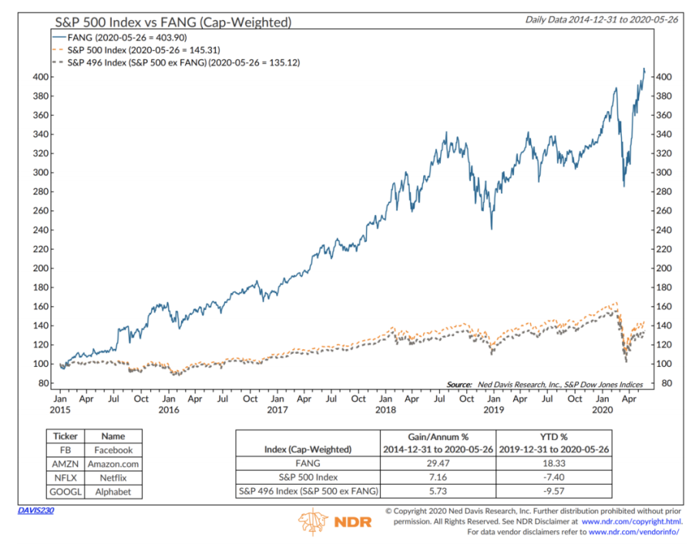
Motivation – Data – Digital
The Facebook Effect
The virtualization of human relationships
The Amazon Effect
The virtualization of customer experience
The Netflix Effect
Entertainment , Virtual Engagement
The Google Effect
The separation of humans and information
The Skype Effect
Free communications, death of distance
The LinkedIn Effect
The virtualization of specialized knowledge
Every Company Is a Data Company https://www.forbes.com/sites/ciocentral/2018/09/26/every-company-is-a-data-company/#f81b61f5cfc5

Slide 5
Fundamental Forces
Law | Meaning | Implications
Moore’s Law | The number of transistors per square inch on an integrated chip doubles every 18 months. | Computers are getting exponentially faster. The cost of data processing is approaching zero.
Metcalfe’s Law | The value of a network is equal to the square of the number of users connected to it. | More digital devices are being connected together. The value of digital and social networks is increasing exponentially.
Nielsen’s Law | Network connection speeds for high-end users will increase by 50 percent per year. | Network speed is increasing. Higher speeds enable new products, platforms, and companies.
Kryder’s Law | The storage density on magnetic disks is increasing at an exponential rate. | Storage capacity is increasing exponentially. The cost of storing data is approaching zero.

Slide 6
ITS journey @IIML
Core
Information Technology Concepts (0.5 Credits)
Management Information Systems
Eelectives
Business Data Communication
Digital Transformation
Big Data Analytics
Competing in the Age of AI
Agile Product and Project Management
Spreadsheet Modeling
Enterprise IT Risk Management
E-commerce
Notes:
What do you mean by more efficiently and productively
1. Saving Time
2. New and improved approaches for analyzing important business
You can see, 95% of MBA students at Indiana University took Authors spreadsheet modeling class even though it was an elective.

Slide 7
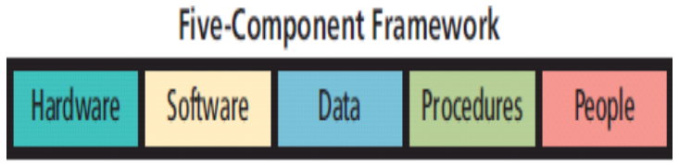
IT – IS – MIS
Information Technology - What comes to mind?
INFRA – Hardware (storage/processing power)
Software (logical/programming power)
Peripheral equipment’s that inputs/outputs Data (Can communicate i.e. including IoT devices)
Information Systems
Management Information systems – Key elements
Management and Use
Information Systems
Strategies
Notes:
“Information Technology” as per https://hbr.org/1958/11/management-in-the-1980s
First part includes techniques for processing large amounts of information rapidly, and it is epitomized by the high-speed computer
Second part centres around aapplication of statistical and mathematical methods to decision-making problems (mathematical programing, and by methodologies like operations research)
Third part is in the offing, though its applications have not yet emerged very clearly; it consists of the simulation of higher-order thinking through computer programs

Slide 8
Course Outline
“The worksheet is the canvas for the business analyst” that enables us to model most of the situations virtually
Classes 1 – 5
Analytics Revolution (Ch. 28)
Spreadsheet Modeling - Create Range Names - Paste Special - Sorting in Excel - Importing data - Validating data (Ch. 1, 2, 14, 25, 39, 42)
Data Types of Spreadsheets - Number, Text, Date/Time - Basic Mathematical functions (Ch. 6, 7, 13, 50, 51).
Data Referencing - Absolute, Relative, vlookup, Index, Match, Offset, Indirect (Ch. 3, 4, 5, 11, 22, 23)
Classes 6 – 10
Data Analysis - If, And, Or, Not, Countif, Countifs, Sumif, Sumifs, Averageif, Averageifs (Ch. 12, 20, 21)
What if Analysis - Goal Seek, Data Table, Scenario Manage (Ch. 17, 18, 19)
Reporting and Data Visualization - Pivot Table, Pivot Charts, Table, Charts (Ch. 24, 26, 45, 54)
Notes:
In this session, we will
1. Understand how increasingly standardized data, access to third-party data sets, cheap, fast computing and easier-to-use software are collectively enabling a new age of decision making.
2. Be familiar with some of the enterprises that have benefited from data-driven, fact-based decision making.

Slide 9
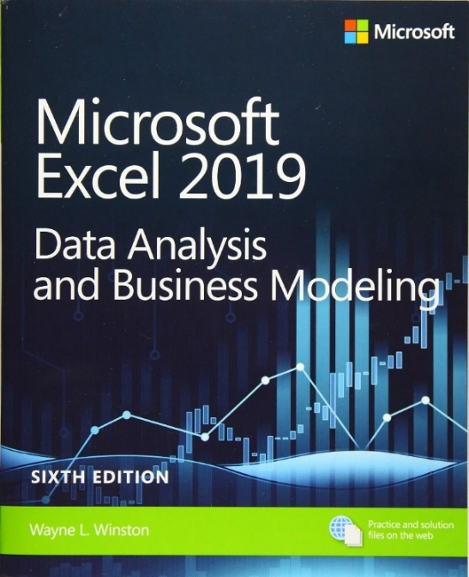
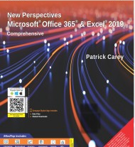
Books and Links
https://www.microsoftpressstore.com/store/microsoft-excel-2019-data-analysis-and-business-modeling-9781509305889#downloads
https://ptgmedia.pearsoncmg.com/imprint_downloads/microsoftpress/bookreg/9781509305889/9781509305889_OnlineFiles3.zip
Wayne L Winston Microsoft Excel 2019 Data Analysis and business Modeling, Microsoft Press
New Perspectives Microsoft® Office 365® & Excel® 2019 Comprehensive, Patrick Carey, Katherine T. Pinard, Ann Shaffer, Mark Shellman, Sasha Vodnik, 1ed, Cengage Publisher
The StudentDataFiles for 'Parsons' Excel 2016.rar can be downloaded from this link: https://bit.ly/3NJiMYi
Notes:
In this session, we will
1. Understand how increasingly standardized data, access to third-party data sets, cheap, fast computing and easier-to-use software are collectively enabling a new age of decision making.
2. Be familiar with some of the enterprises that have benefited from data-driven, fact-based decision making.

Slide 10
Case Links – Single Click
1. Good Modelling Practices in Microsoft Excel W16408-PDF-ENG https://hbsp.harvard.edu/tu/026a813b 2. Absolute and Relative References In Microsoft Excel W16406-PDF-ENG https://hbsp.harvard.edu/tu/f7bd9e42 Absolute and Relative References In Microsoft Excel, Student Spreadsheet W16407-XLS ENG https://hbsp.harvard.edu/tu/fe922d11 3. Advanced Logic Functions in Microsoft Excel W16415-PDF-ENG https://hbsp.harvard.edu/tu/f6f981b7 Advanced Logic Functions in Microsoft Excel, Student Spreadsheet W16416-XLS-ENG https://hbsp.harvard.edu/tu/6e12863f 4. Goal Seek in Microsoft Excel W16419-PDF-ENG https://hbsp.harvard.edu/tu/3ff6daa2 Goal Seek in Microsoft Excel, Student Spreadsheet W16420-XLS-ENG https://hbsp.harvard.edu/tu/9086793f 5. Data Tables in Microsoft Excel W16417-PDF-ENG https://hbsp.harvard.edu/tu/1340b815 Data Tables in Microsoft Excel, Student Spreadsheet W16418-XLS-ENG https://hbsp.harvard.edu/tu/9db1a0b3 6. A Few Excel Tips: Data Validation Tool, Offset and Vlookup, Dynamic Charts, Form Controls, Pivot Tables, VBA W11300-PDF-ENG https://hbsp.harvard.edu/tu/3890dc72
Notes:
In this session, we will
1. Understand how increasingly standardized data, access to third-party data sets, cheap, fast computing and easier-to-use software are collectively enabling a new age of decision making.
2. Be familiar with some of the enterprises that have benefited from data-driven, fact-based decision making.

Slide 11
Pedagogy
Medium (Awareness)
Advanced (Experienced)
Basic
(New)
Project
(Practice)
Case Studies
(Trends)
e-Book
(Theory)
Knowledge Levels
Coverage in ITC
Assessment (Individual)
End exam – 50%
Quizzes – 20%
Assessment (Group contribution)
Project – 20%
Class participation – 10%

Slide 12
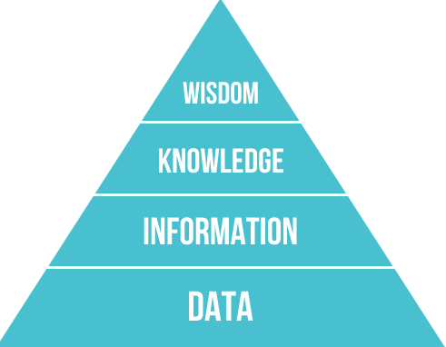
The Analytics Revolution – Data Pyramid
Analytics is the practice of using data to help make decisions that better meet an organization’s objectives.
Competing on Analytics (Harvard Business Review Press) - Thomas Davenport’s in 2007.
Frequently hear
Data is new oil of business economy
Data Scientist is sexiest job of the 21st century
Data Rich, Information Poor
Garbage In and Garbage Out
Data comes from
Transaction Processing Systems
Enterprise Software (CRM, SCM, and ERP)
Survey
External Sources
Data Aggregator
Notes:
In this session, we will
1. Understand how increasingly standardized data, access to third-party data sets, cheap, fast computing and easier-to-use software are collectively enabling a new age of decision making.
2. Be familiar with some of the enterprises that have benefited from data-driven, fact-based decision making.

Slide 13
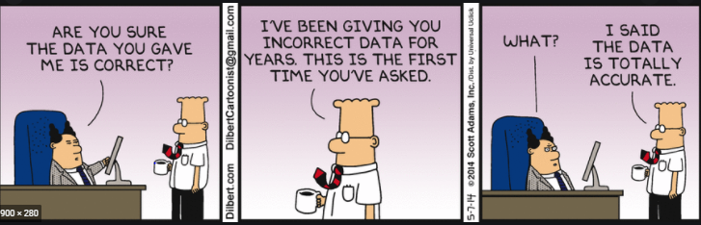
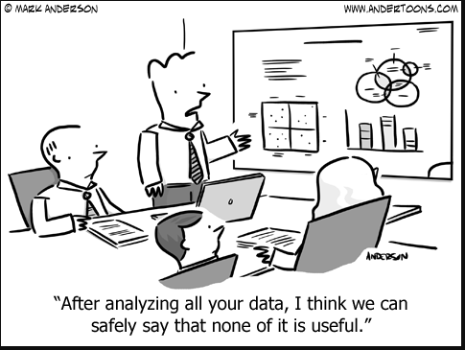
The Analytics Revolution – Challenges
With Challenges
Sourcing
Relevance
Quantity
Quality
Hosting
Governance
Skills Required
Understand and manipulate data in any form (including text)
Bring disparate data sets together
Statistics, Algorithms and Simulation
Program in a language such as Java or Python
Analyse big data sets using statistical packages like ‘R’
Notes:
In this session, we will
1. Understand how increasingly standardized data, access to third-party data sets, cheap, fast computing and easier-to-use software are collectively enabling a new age of decision making.
2. Be familiar with some of the enterprises that have benefited from data-driven, fact-based decision making.

Slide 14
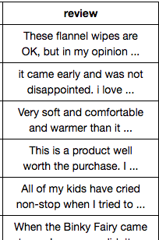
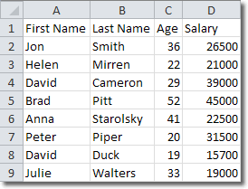
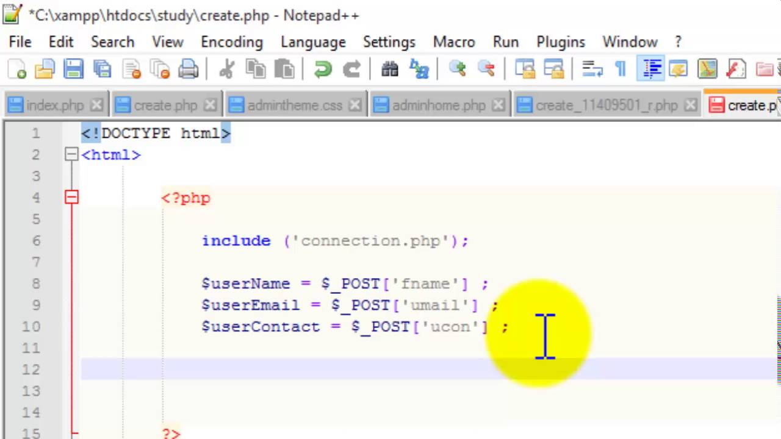
Types of Data
Structured Data
Semi-structured Data
Unstructured Data
Notes:
In this session, we will
1. Understand how increasingly standardized data, access to third-party data sets, cheap, fast computing and easier-to-use software are collectively enabling a new age of decision making.
2. Be familiar with some of the enterprises that have benefited from data-driven, fact-based decision making.

Slide 15
Types of Data
Structured Data
Computer or Machine Generated Structured Data : Sensor data – Web log data – Point of sale data – Financial data
Human Generated Data: Input data – Click stream data – Gaming related data
Semi-Structured Data
Social media data: Generated from the social media platforms such as YouTube, Facebook, Twitter, LinkedIn, and Flickr.
Unstructured Data
Computer or Machine Generated Structured Data : Satellite images - Scientific data - Photographs and video (surveillance, and traffic video) - Radar or sonar data
Human-generated Unstructured Data Examples : Mobile and Voice data - Web behaviour and content - Image and Video Data – customer behaviour

Slide 16
Big Data – Definition
Webopedia: Big data is used to describe a massive volume of both structured and unstructured data that is so large that it's difficult to process using traditional database and software techniques.
Gartner: Big data is high volume, high velocity, and/or high variety information assets that require new forms of processing to enable enhanced decision making, insight discovery and process optimization.
National Institute of Standards and Technology (USA): Big Data consists of extensive datasets, primarily in the characteristics of volume, velocity, and/or variety that require a scalable architecture for efficient storage, manipulation, and analysis.

Slide 17
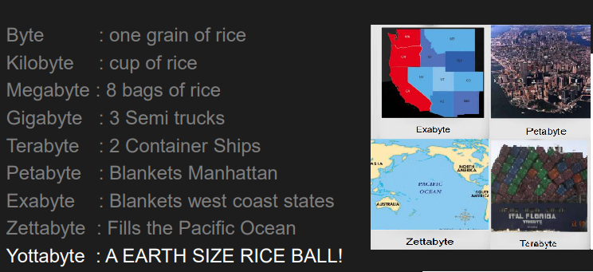
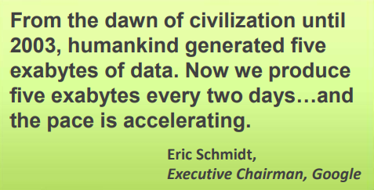
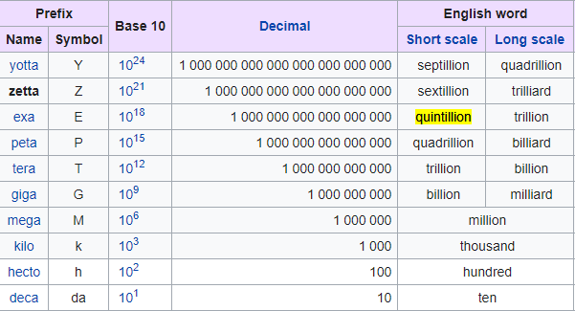
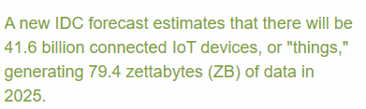
Big Data – Visualization

Slide 18
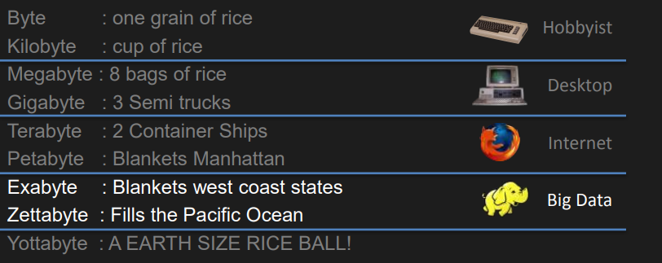

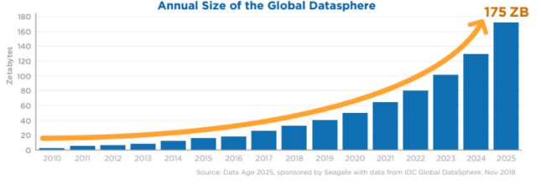
Big Data – Visualization

Slide 19
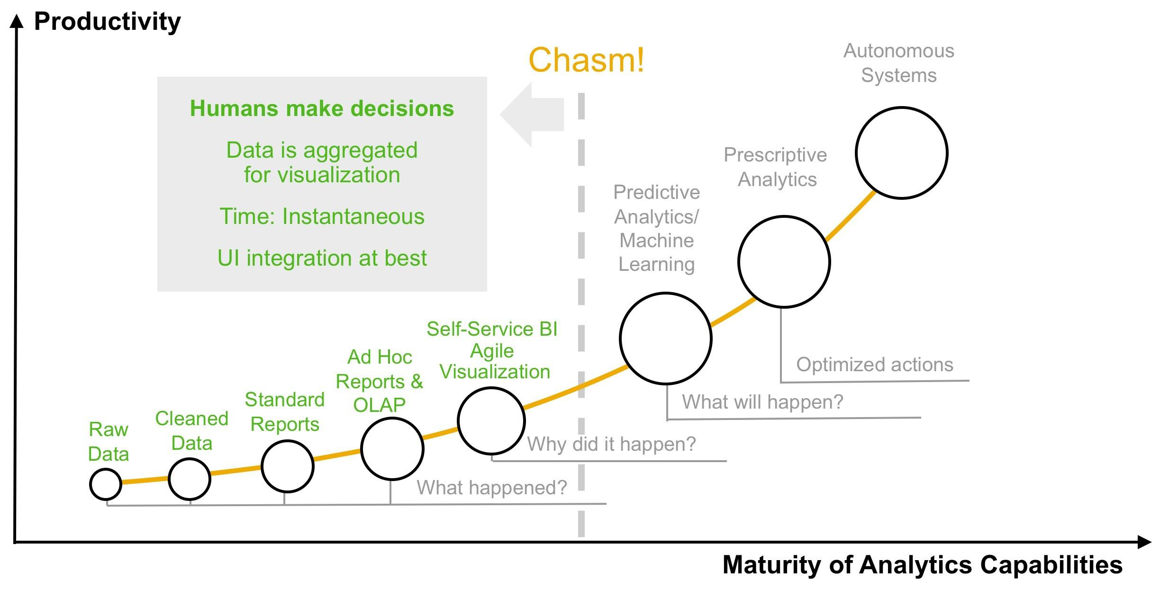
Evolution of Analytics

Slide 20
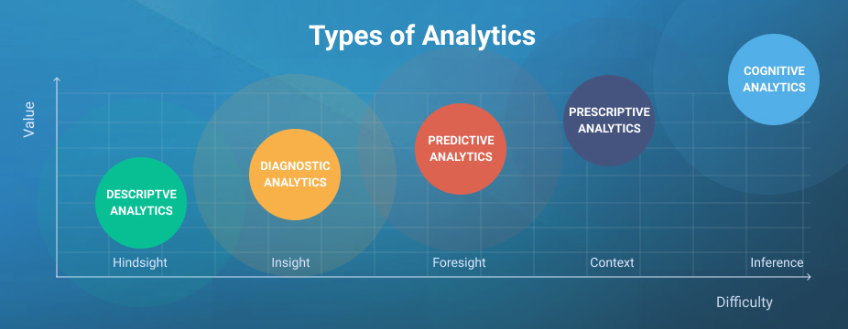
Evolution of Analytics

Slide 21
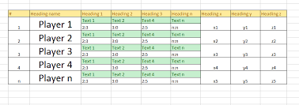
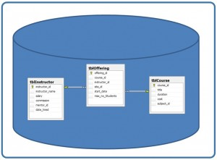
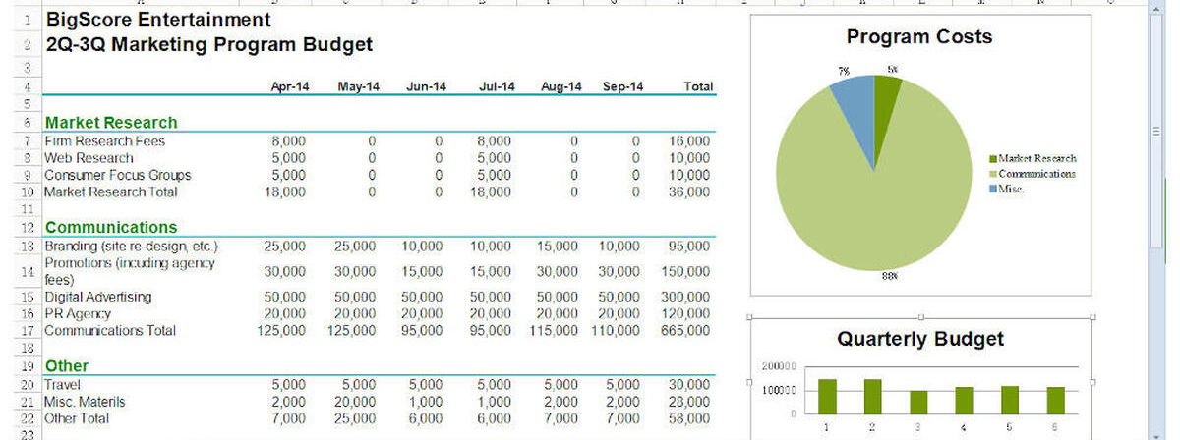
Let us differentiate
Table →
← Data Base
Microsoft Excel
Google Sheets
iWork Numbers - Apple Suite.
LibreOffice -> Calc (free).
Lotus 1-2-3 (discontinued).
Lotus Symphony - Spreadsheets.
OpenOffice -> Calc (free).
Spreadsheet →

Slide 22
Installing Excel 2019
Instructions from Computer Center to Install Excel 2019. You can call the contact below (0522-6696951,52) for additional support if any. Please find MS Office 2019 google drive link below. Students have to copy the entire folder to C drive root directory after downloading and uninstall any other office version from their laptop/desktop. For installation open a folder and run installation named batch file. After installation please provide a remote session for activation through anydesk/teamviewer. Link is-- https://drive.google.com/drive/folders/1HkQ1d2twNcmOpxP-p5ipO_aPD0iFgOTK?usp=sharing Thanks & Regards : Technical Service Desk(TSD) IIM - Prabandh Nagar, Off Sitapur Road, Lucknow - 226013 Contact : 0522-6696951,52

Slide 23
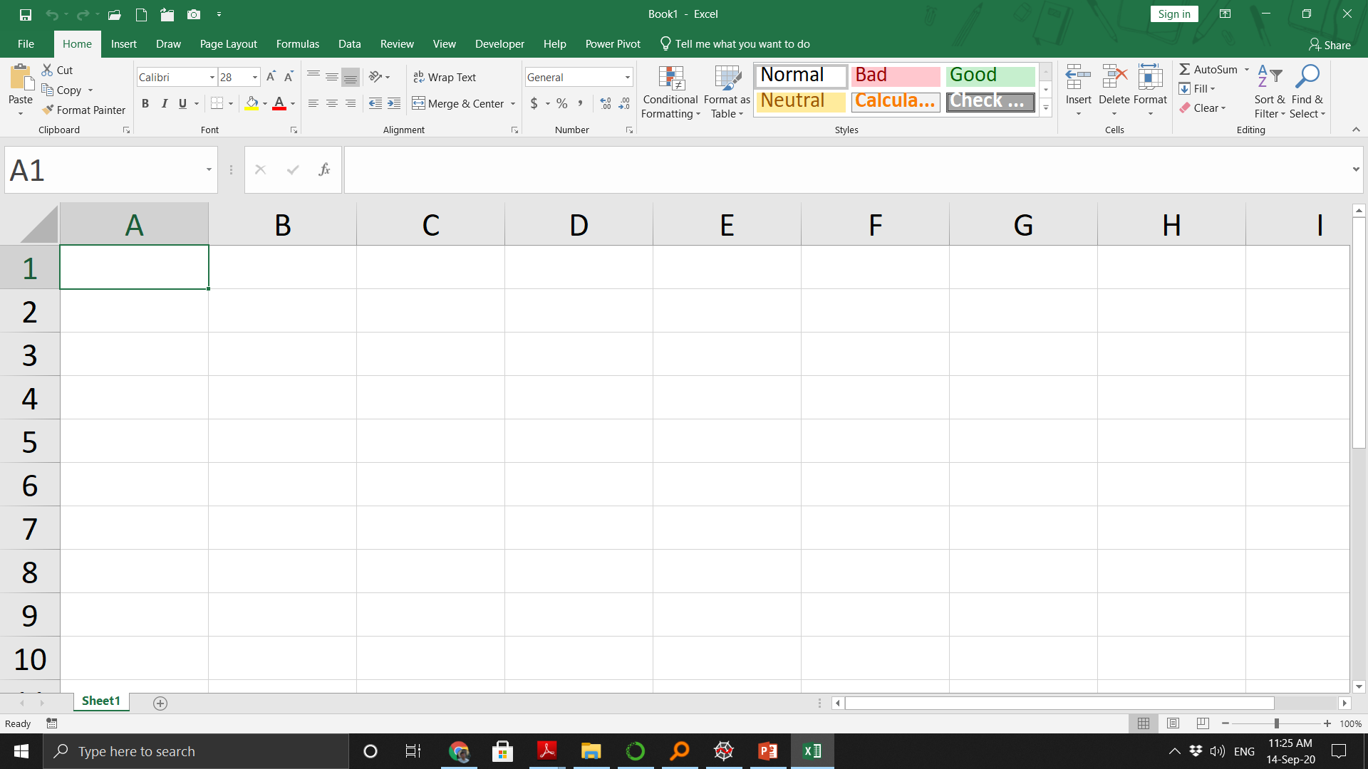
Tab
Ribbon
Quick Access Toolbar
Formula Bar
Name Bar
Column Name
Row Number
Select all Button
Active Cell
Vertical Scroll Bar
Worksheet Name
Zoom Select
Horizontal Scroll Bar

Slide 24

Good Modelling Practices in Microsoft Excel (Case 1)
Real Life Example
IT offshoring cost, ROI projections for 1/3rd of work offshoring (Large Deal-ROI.XLS)
Interesting Problems
A lake is currently stocked with 12,230 fish. the number of births per fish is 1.2 and deaths is 0.7. How may fishes to harvest so that the number of fishes remains constant. (Tab - Fish Harvesting )
Notes:
In this session, we will
1. Understand how increasingly standardized data, access to third-party data sets, cheap, fast computing and easier-to-use software are collectively enabling a new age of decision making.
2. Be familiar with some of the enterprises that have benefited from data-driven, fact-based decision making.

Slide 25
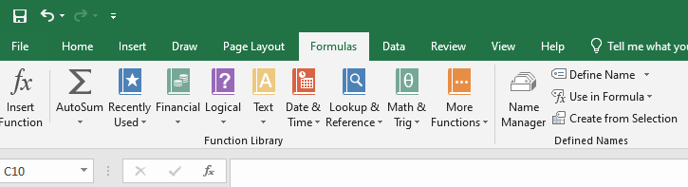

Create Ranged Names
By entering a range name in the Name box
From the Name Manager
Create from selection
Note
If you use Create From Selection to create a range name and your name contains spaces, Excel inserts an underscore (_) to fill in the spaces.
The only symbols allowed in range names are periods (.) and underscores (_).
Range names cannot begin with numbers or look like a cell reference.
3Q and A4
CAT1
Notes:
What do you mean by more efficiently and productively
1. Saving Time
2. New and improved approaches for analyzing important business
You can see, 95% of MBA students at Indiana University took Authors spreadsheet modeling class even though it was an elective.

Slide 26
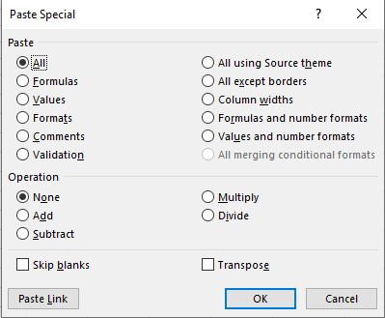
Paste Special
Paste only the values in cells (not the formulas)
Transpose data in columns to rows and vice versa
Transform a range of numbers (+, -, %, *) by a given constant
Notes:
What do you mean by more efficiently and productively
1. Saving Time
2. New and improved approaches for analyzing important business
You can see, 95% of MBA students at Indiana University took Authors spreadsheet modeling class even though it was an elective.

Slide 27
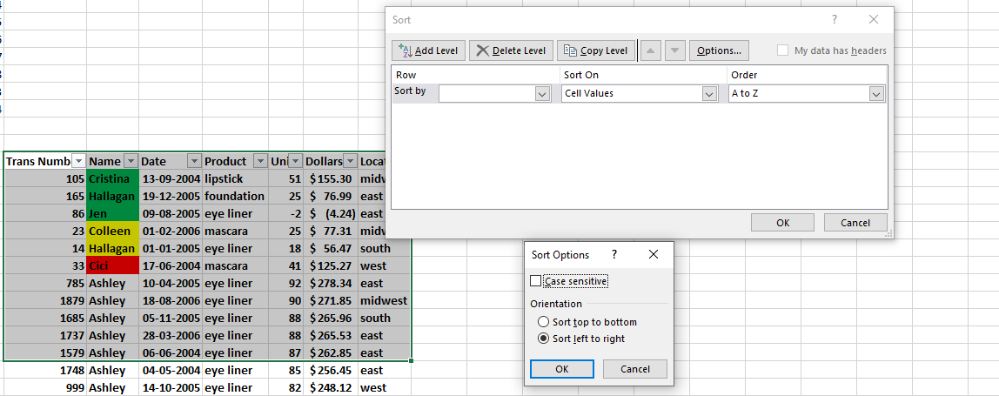
Sorting in EXCEL
Data → Sort & Filter Group
Sorting in Excel - Add Level, Case sensitive, by Color
Custom list (For sorting by months OR predefined values)
File → Options → Advanced …Scroll down → General → Edit Custom Lists
Note:
64 criteria can be applied in one sort
Notes:
What do you mean by more efficiently and productively
1. Saving Time
2. New and improved approaches for analyzing important business
You can see, 95% of MBA students at Indiana University took Authors spreadsheet modeling class even though it was an elective.

Slide 28
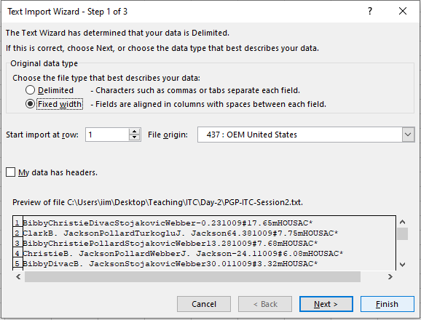
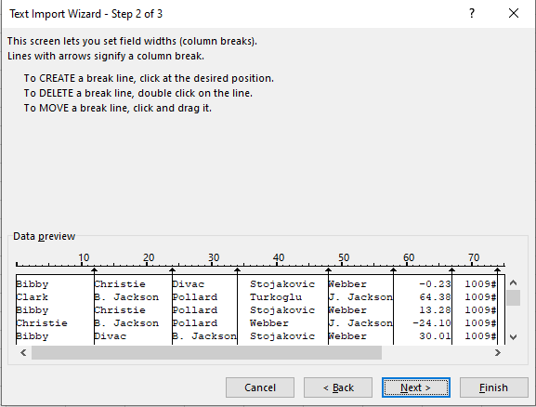
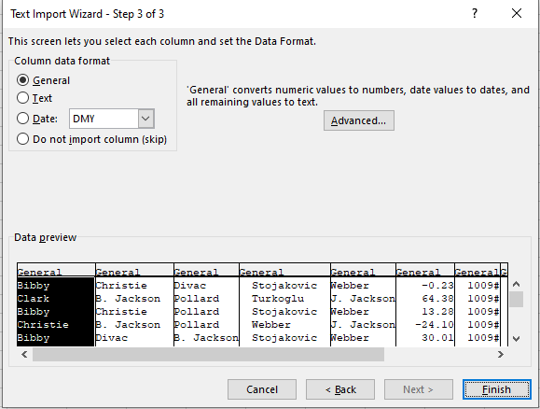
Importing data from a word / text file
File → Save As → Plain Text (.txt) ; File → Open → All Files (*.*)
General → Treat numerical data as numbers, others as text.
Notes:
In this session, we will
1. Understand how increasingly standardized data, access to third-party data sets, cheap, fast computing and easier-to-use software are collectively enabling a new age of decision making.
2. Be familiar with some of the enterprises that have benefited from data-driven, fact-based decision making.

Slide 29
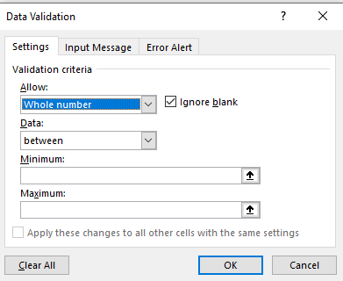

Validating Data
Data → Data validation Tab
Custom Error alerts
Custom settings along with formulas
To see only numbers to be entered, use ISNUMBER(A1) function
Here the validation function copies for each cell
Usage in combination with “named the range”
Useful when abbreviations to be used from selected list.
View the error cells after applying validation
Circle invalidate Data
Clear the circles
ISNUMBER : Check if the value is number and then returns True of False
Notes:
What do you mean by more efficiently and productively
1. Saving Time
2. New and improved approaches for analyzing important business
You can see, 95% of MBA students at Indiana University took Authors spreadsheet modeling class even though it was an elective.

Slide 30
Readings / References
MS Excel 2019 Data Analysis and Business Modeling, by Wayne L Winston, Microsoft Press
Chapter – 1, 2, 14, 25, 28, 39 and 42
Good Modelling Practices in Microsoft Excel (W16408-PDF-ENG)
THANK YOU

